Slide 1
CPSC3300: Computer Systems Organization
Lectures 21 & 22 – Virtual Memory

Slide 2
Administrivia
HW5 available
Due 11:59pm April 16
Project 3 available
Due 11:59pm April 25
Reading
Chp. 5.7

Slide 3
Review: The Memory Hierarchy
Take advantage of the principle of locality to present the user with as much memory as is available in the cheapest technology at the speed offered by the fastest technology
Processor
4-8 bytes (word)
Inclusive– what is in L1$ is a subset of what is in L2$ is a subset of what is in MM that is a subset of is in SM
Increasing distance from the processor in access time
L1$
8-64 bytes (block)
L2$
1 to 4 blocks
Main Memory
1,024+ bytes (disk sector = page)
Secondary Memory
(Relative) size of the memory at each level

Slide 4
History
Virtual memory was developed in approximately 1959 – 1962, at the University of Manchester for the Atlas Computer, completed in 1962.
In 1961, Burroughs released the B5000, the first commercial computer with virtual memory.

Slide 5
Why is it needed….
Before the development of the virtual memory technique, programmers in the 1940s and 1950s had to manage directly two-level storage such as main memory or ram and secondary memory in the form of hard disks or earlier, magnetic drums.
Enlarge the address space, the set of addresses a program can utilize.
Virtual memory is typically larger than physical memory.

Slide 6
Objective
When a computer is executing many programs at the same time, virtual memory makes it possible for the computer to share memory efficiently.
Virtual memory create an illusion that the program has its own dedicated memory
Eliminate a restriction posed by small sized physical memory
When many programs are running at the same time, by distributing each suitable memory area to each program, VM protects programs from interfering each other in each memory area.

Slide 7
How does it work…
To facilitate copying virtual memory into real memory, the operating system divides virtual memory into pages, each of which contains a fixed number of addresses.
Each page is stored on a disk until it is needed.
When the page is needed, the operating system copies it from disk to main memory, translating the virtual addresses into real addresses.

Slide 8
MMU (Memory Management Unit)
The hardware base that makes a virtual memory system possible.
Allows software to reference physical memory by virtual addresses, quite often more than one.
It accomplishes this through the use of page and page tables.
In addition to page, segmentation is another mechanism
We focus on paging, which is simpler
Use a section of memory to translate virtual addresses into physical addresses via a series of table lookups.
The software that handles the page fault is generally part of an operating system and the hardware that detects this situation.

Slide 9
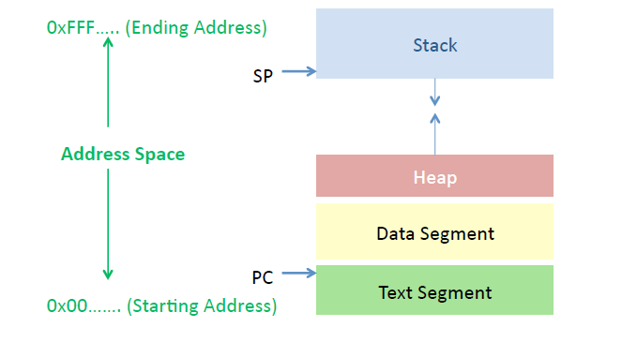
Program Address Space

Slide 10
Virtual Memory (Paging)
Page table
Page table
Address Space
Address Space
Physical
Memory

Slide 11
Hardware and Control Structures
Memory references are dynamically translated into physical addresses at run time
A process may be swapped in and out of main memory such that it occupies different regions

Slide 12
Hardware and Control Structures
A process may be broken up into pieces, which do not need to be located contiguously in main memory
It is not necessary for all pieces of a process to be loaded in main memory during execution of the process

Slide 13
Execution of a Program
Operating system brings into main memory a few pieces of the program
Resident set -- portion of process that is in main memory
An interrupt is generated when an address is needed that is not in main memory
Operating system places the process in a blocking state

Slide 14
Execution of a Program
Piece of process that contains the logical address is brought into main memory
Operating system issues a disk I/O Read request
Another process is dispatched to run while the disk I/O takes place
An interrupt is issued when disk I/O complete which causes the operating system to place the affected process in the Ready state

Slide 15
Improved System Utilization
More processes may be maintained in main memory
Only load in some of the pieces of each process
With so many processes in main memory, it is very likely a process will be in the Ready state at any particular time
A process may be larger than all of main memory

Slide 16
Thrashing
Swapping out a piece of a process just before that piece is needed
The processor spends most of its time swapping pieces rather than executing user instructions

Slide 17
Principle of Locality
Program and data references within a process tend to cluster
Only a few pieces of a process will be needed over a short period of time
Possible to make intelligent guesses about which pieces will be needed in the future
This suggests that virtual memory may work efficiently

Slide 18
Paging
Each process has its own page table
Each page table entry contains the frame number of the corresponding page in main memory
A bit is needed to indicate whether the page is in main memory or not

Slide 19
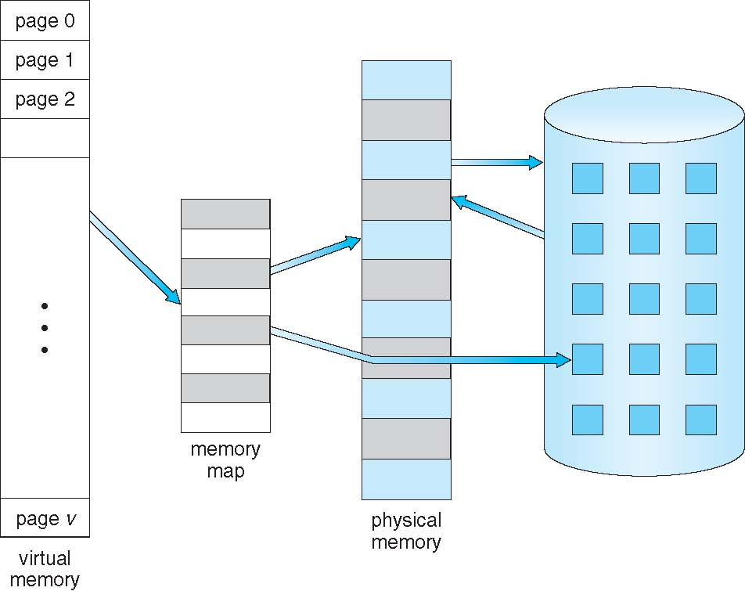
Virtual Memory That is Larger Than Physical Memory

Slide 20
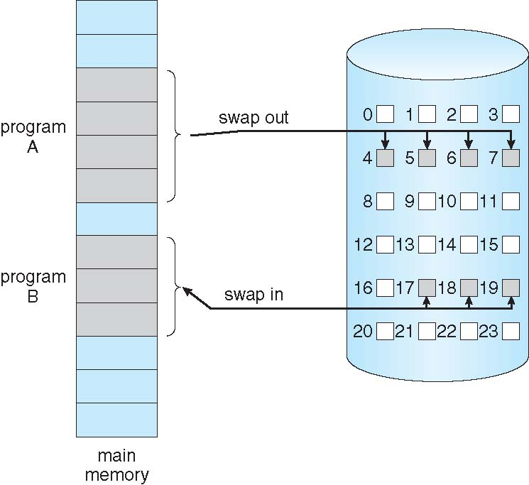
Transfer of a Paged Memory to Contiguous Disk Space

Slide 21
Demand Paging for Virtual Memory
Bring a page into memory ONLY when it is needed
Less I/O needed
Less memory needed
Faster response
More users supported
Check a page table entry when a page is needed
not-in-memory ⇒ bring to memory

Slide 22
Valid-Invalid Bit
With each page table entry a valid–invalid bit is associated (v ⇒ in-memory, i ⇒ not-in-memory)
Initially valid–invalid bit is set to i on all entries
Not in memory ⇒ page fault
Frame #
valid-invalid bit
v
v
v
v
i
….
i
i
page table

Slide 23
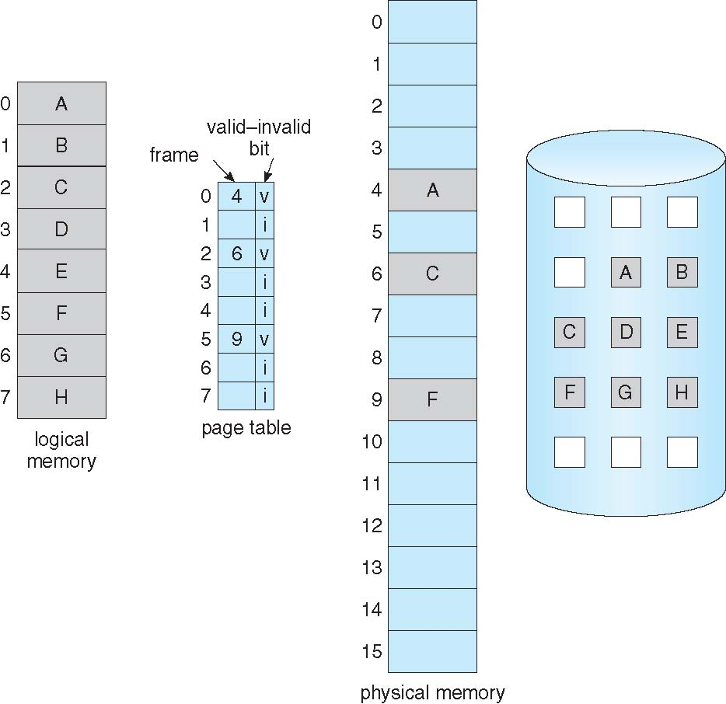
Page Table When Some Pages Are Not in Main Memory
Logical memory: page as the unit
Physical memory: frame as the unit
Page table:
Map from page number to frame number

Slide 24
User/Process Perspective
Users (and processes) view memory as one contiguous address space from 0 to N
Virtual address space
In reality, pages are scattered throughout physical storage
The mapping is invisible to the program
Protection is provided because a program cannot reference memory outside of its virtual address space
The address “0x1000” maps to different physical addresses in different processes

Slide 25
Paging
Translating addresses
Virtual address has two parts: virtual page number and offset
Virutal page number (VPN) is an index into a page table
Page table determines page frame number (PFN)
Physical address is PFN::offset (:: concatenation, << left shift)

Slide 26
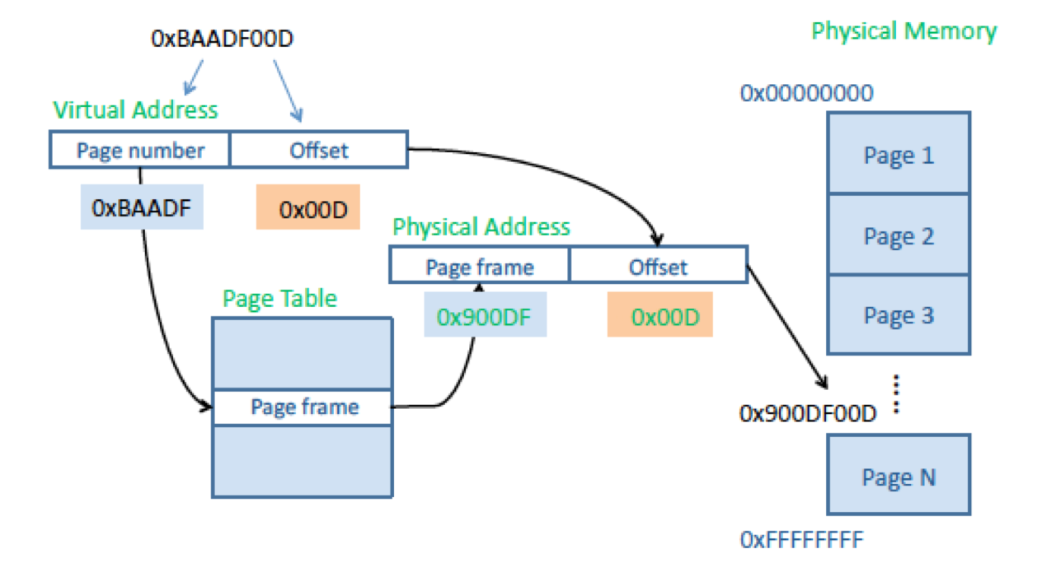
Page Lookups

Slide 27
Paging Example
Memory address is 32 bits
Pages are 4K
VPN is _____ bits (____VPNs), offset is ____ bits
Virtual address is 0x7468
Virtual page is ____, offset is _____
Page table entry _____ contains 0x2
Page frame base is 0x2 << _____ = _______
______th virtual page is address _______(3rd physical page)
Physical address = ______ + _______ = ________

Slide 28
Paging Example
Memory address is 32 bits
Pages are 4K
VPN is __20___ bits (_1M___VPNs), offset is _12___ bits
Virtual address is 0x7468
Virtual page is _0x7___, offset is __0x468___
Page table entry _0x7____ contains 0x2
Page frame base is 0x2 << __12___bits = _0x2000______
___7___th virtual page is address __0x2000___(3rd physical page)
Physical address = _0x2000__ + _0x468__ = _0x2468___

Slide 29
Page Size
Smaller page size, less amount of internal fragmentation
Smaller page size, more pages required per process
More pages per process means larger page tables
Larger page tables means large portion of page tables in virtual memory

Slide 30
Page Size
Secondary memory is designed to efficiently transfer large blocks of data so a large page size is better

Slide 31
Page Size
Small page size, large number of pages will be found in main memory
As time goes on during execution, the pages in memory will all contain portions of the process near recent references. Page faults low.
Increased page size causes pages to contain locations further from any recent reference. Page faults rise.

Slide 32
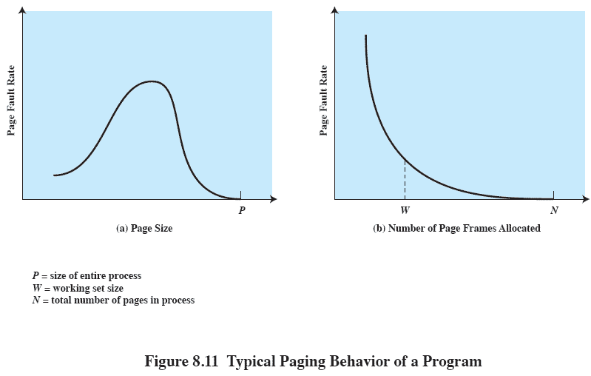
Page Size

Slide 33
Page Tables
Page tables are also stored in virtual memory
When a process is running, part of its page table is in main memory

Slide 34
Translation Lookaside Buffer
Each virtual memory reference can cause two physical memory accesses
One to fetch the page table
One to fetch the data
To overcome this problem a high-speed cache is set up for page table entries
Called a Translation Lookaside Buffer (TLB)
Contains page table entries that have been most recently used

Slide 35
Translation Lookaside Buffer
Given a virtual address, processor examines the TLB
If page table entry is present (TLB hit), the frame number is retrieved and the real address is formed
If page table entry is not found in the TLB (TLB miss), the page number is used to index the process page table

Slide 36
Making Address Translation Fast
Virtual page #
Physical page
base addr
V
VPN
1
1
1
0
1
1
TLB
Physical page
base addr
V
1
1
1
1
1
1
0
1
0
1
0
2
Main memory
Page Table
(in physical memory)
Disk storage

Slide 37
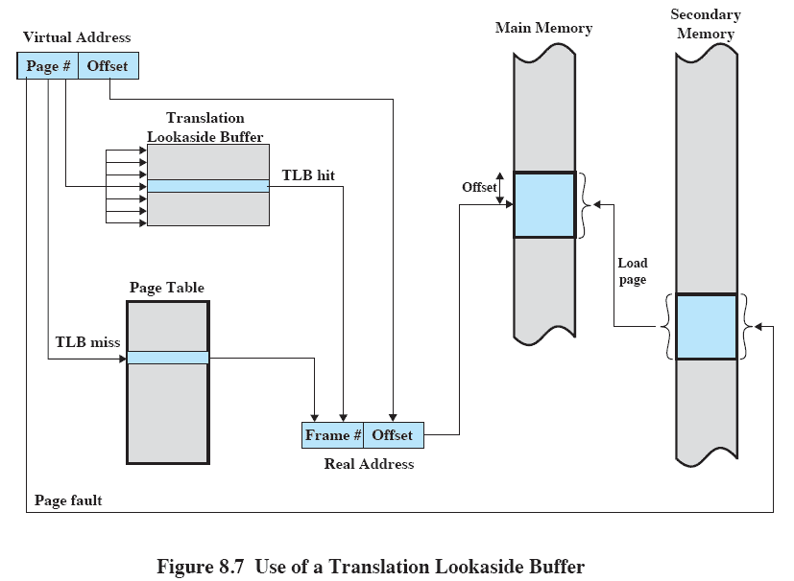
Translation Lookaside Buffer
1
2
3

Slide 38
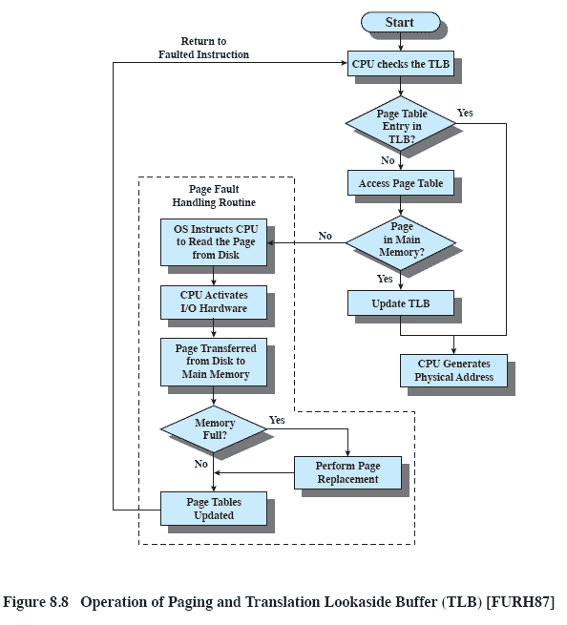
Translation Lookaside Buffer

Slide 39
Translation Lookaside Buffers (TLBs)
Just like any other cache, the TLB can be organized as fully associative, set associative, or direct mapped
V Virtual Page # Physical Frame # Dirty Ref Access
TLB access time is typically smaller than cache access time (because TLBs are much smaller than caches)
TLBs are typically not more than 128 to 256 entries even on high end machines

Slide 40
A TLB in the Memory Hierarchy
¼ t
hit
¾ t
VA
PA
miss
TLB
Lookup
Cache
Main
Memory
CPU
miss
hit
Trans-
lation
A physically indexed, physically tagged (PIPT) cache.
Other caches: VIVT, VIPT, PIVT
data
A TLB miss – is it a page fault or merely a TLB miss?
If the page is loaded into main memory, then the TLB miss can be handled (in hardware or software) by loading the translation information from the page table into the TLB
Takes 10’s of cycles to find and load the translation info into the TLB
If the page is not in main memory, then it’s a true page fault
Takes 1,000,000’s of cycles to service a page fault
TLB misses are much more frequent than true page faults

Slide 41
Some Virtual Memory Design Parameters
 | Paged VM | TLBs
Total size | 16,000 to 250,000 pages | 16 to 512 entries
Total size (KB) | 250,000 to 1,000,000,000 | 0.25 to 16
Block size (B) | 4000 to 64,000 | 4 to 32
Miss penalty (clocks) | 10,000,000 to 100,000,000 | 10 to 1000
Miss rates | 0.00001% to 0.0001% | 0.01% to 2%

Slide 42
Two Machines’ Cache Parameters
 | Intel P4 | AMD Opteron
TLB organization | 1 TLB for instructions and 1TLB for data Both 4-way set associative Both use ~LRU replacement Both have 128 entries TLB misses handled in hardware | 2 TLBs for instructions and 2 TLBs for data Both L1 TLBs fully associative with ~LRU replacement Both L2 TLBs are 4-way set associative with round-robin LRU Both L1 TLBs have 40 entries Both L2 TLBs have 512 entries TBL misses handled in hardware
Notes:
A trace cache finds a dynamic sequence of instructions including taken branches to load into a cache block. Thus, the cache blocks contain dynamic traces of the executed instructions as determined by the CPU rather than static sequences of instructions as determined by memory layout. It folds branch prediction into the cache.

Slide 43
Page fault
An interrupt to the software raised by the hardware when a program accesses a page that is not mapped in physical memory.
when a program accesses a memory location in its memory and the page corresponding to that memory is not loaded
when a program accesses a memory location in its memory and the program does not have privileges to access the page corresponding to that memory.

Slide 44
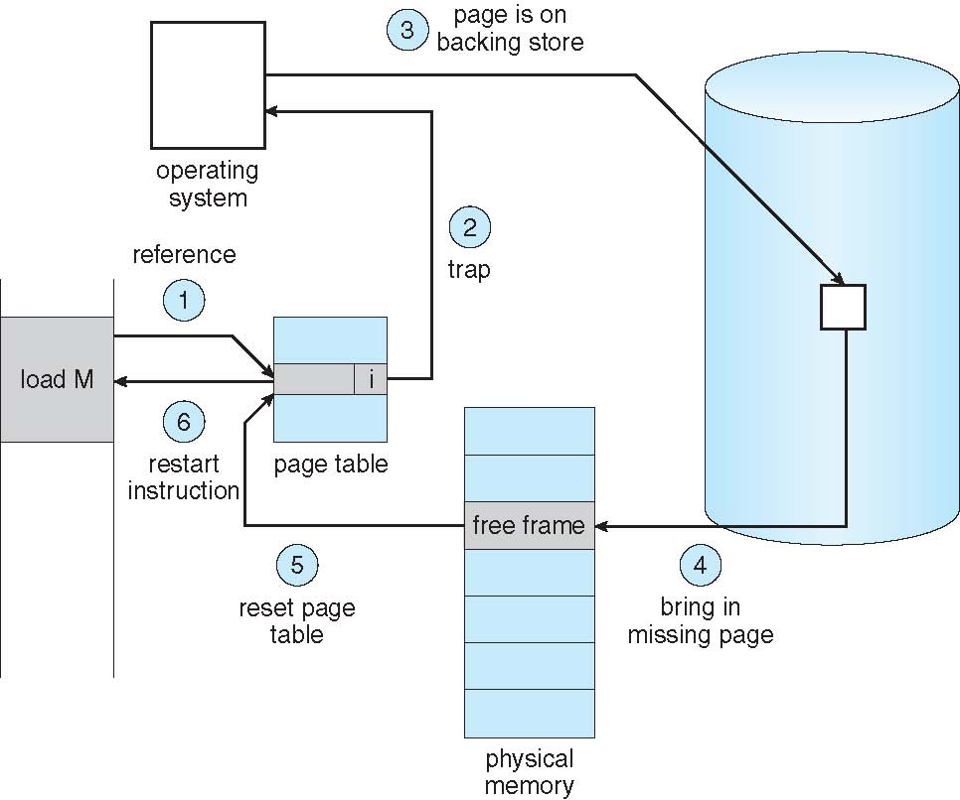
Steps in Handling a Page Fault

Slide 45
Paging replacement algorithms
OPT(MIN) : eliminate the page that be not expected to be used.
FIFO(first input/first output) : rather than choosing the victim page at random, the oldest page is the first to be removed.
LRU(Least Recently used) : move out the page that is the least rarely used.
LFU(Least Frequently used) : move out the page that is not used often in the past.

Slide 46
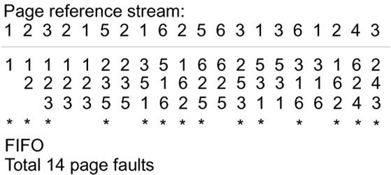
Replacement Policy
Common policies to replace page frames in physical memory
FIFO – first in first out
LRU – Least Recently used
Example: 3 page frames in physical memory, FIFO
Page frame 1
Page frame 2
Page frame 3
fault?

Slide 47
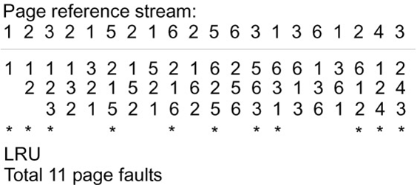
Replacement Policy
Example: 3 page frames in physical memory, LRU
Page frame 1
Page frame 2
Page frame 3
fault?

Slide 48
TLB Event Combinations
TLB | Page Table | Cache | Possible? Under what circumstances?
Hit | Hit | Hit
Hit | Hit | Miss
Miss | Hit | Hit
Miss | Hit | Miss
Miss | Miss | Miss
Hit | Miss | Miss/ Hit
Miss | Miss | Hit

Slide 49
TLB Event Combinations
TLB | Page Table | Cache | Possible? Under what circumstances?
Hit | Hit | Hit
Hit | Hit | Miss
Miss | Hit | Hit
Miss | Hit | Miss
Miss | Miss | Miss
Hit | Miss | Miss/ Hit
Miss | Miss | Hit
Yes – what we want!
Yes – although the page table is not
checked if the TLB hits
Yes – TLB miss, PA in page table
Yes – TLB miss, PA in page table, but data
not in cache
Yes – page fault
Impossible – TLB translation not possible if
page is not present in memory
Impossible – data not allowed in cache if
page is not in memory

Slide 50
The Hardware/Software Boundary
What parts of the virtual to physical address translation is done by or assisted by the hardware?
Translation Lookaside Buffer (TLB) that caches the recent translations
TLB access time is part of the cache hit time
May allot an extra stage in the pipeline for TLB access
Page table storage, fault detection and updating
Page faults result in interrupts (precise) that are then handled by the OS
Hardware must support (i.e., update appropriately) Dirty and Reference bits (e.g., ~LRU) in the Page Tables
Disk placement
Bootstrap (e.g., out of disk sector 0) so the system can service a limited number of page faults before the OS is even loaded

Slide 51
Summary
The Principle of Locality:
Program likely to access a relatively small portion of the address space at any instant of time.
Temporal Locality: Locality in Time
Spatial Locality: Locality in Space
Caches, TLBs, Virtual Memory all understood by examining how they deal with the four questions
Where can block be placed?
How is block found?
What block is replaced on miss?
How are writes handled?
Page tables map virtual address to physical address
TLBs are important for fast translation
Notes:
Let’s summarize today’s lecture. I know you have heard this many times and many ways but it is still worth repeating.
Memory hierarchy works because of the Principle of Locality which says a program will access a relatively small portion of the address space at any instant of time.
There are two types of locality: temporal locality, or locality in time and spatial locality, or locality in space.
So far, we have covered three major categories of cache misses.
Compulsory misses are cache misses due to cold start. You cannot avoid them but if you are going to run billions of instructions anyway, compulsory misses usually don’t bother you.
Conflict misses are misses caused by multiple memory location being mapped to the same cache location.
The nightmare scenario is the ping pong effect when a block is read into the cache but before we have a chance to use it, it was immediately forced out by another conflict miss.
You can reduce Conflict misses by either increase the cache size or increase the associativity, or both.
Finally, Capacity misses occurs when the cache is not big enough to contains all the cache blocks required by the program. You can reduce this miss rate by making the cache larger.
There are two write policy as far as cache write is concerned. Write through requires a write buffer and a nightmare scenario is when the store occurs so frequent that you saturates your write buffer.
The second write polity is write back. In this case, you only write to the cache and only when the cache block is being replaced do you write the cache block back to memory.
+3 = 77 min. (Y:57)

